Slide 1
What is “AI”?
More specifically, how do Large Language Models work?

Slide 2
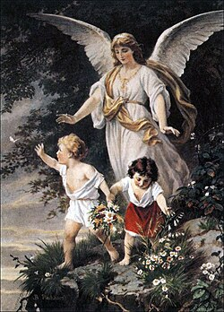
Disclaimer
I am not an expert in AI or LLM
I have built my own “LLM” but it’s a toy
  It’s called Bert_3010 and it’s not allowed to leave my basement
It is in my interest to convince you that AI is just statistics
  Keeps me in a job
  Inflates my ego
I do believe that what I’m saying is true
  But I am not impartial

Slide 3
What’s the difference?
When talking to a CEO, it’s Artificial Intelligence.
When talking to a head of department, it’s Machine Learning.
When talking to a line manager, it’s Data Science.
When talking to a colleague, it’s Statistics.

Slide 4
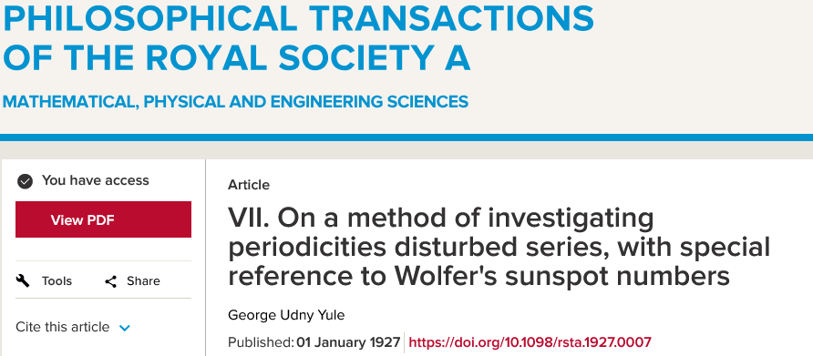
“Statistics is great and all, but it can’t do things like analyse time series”
Professor of Machine Learning Engineering
(from a very prestigious university)

Slide 5
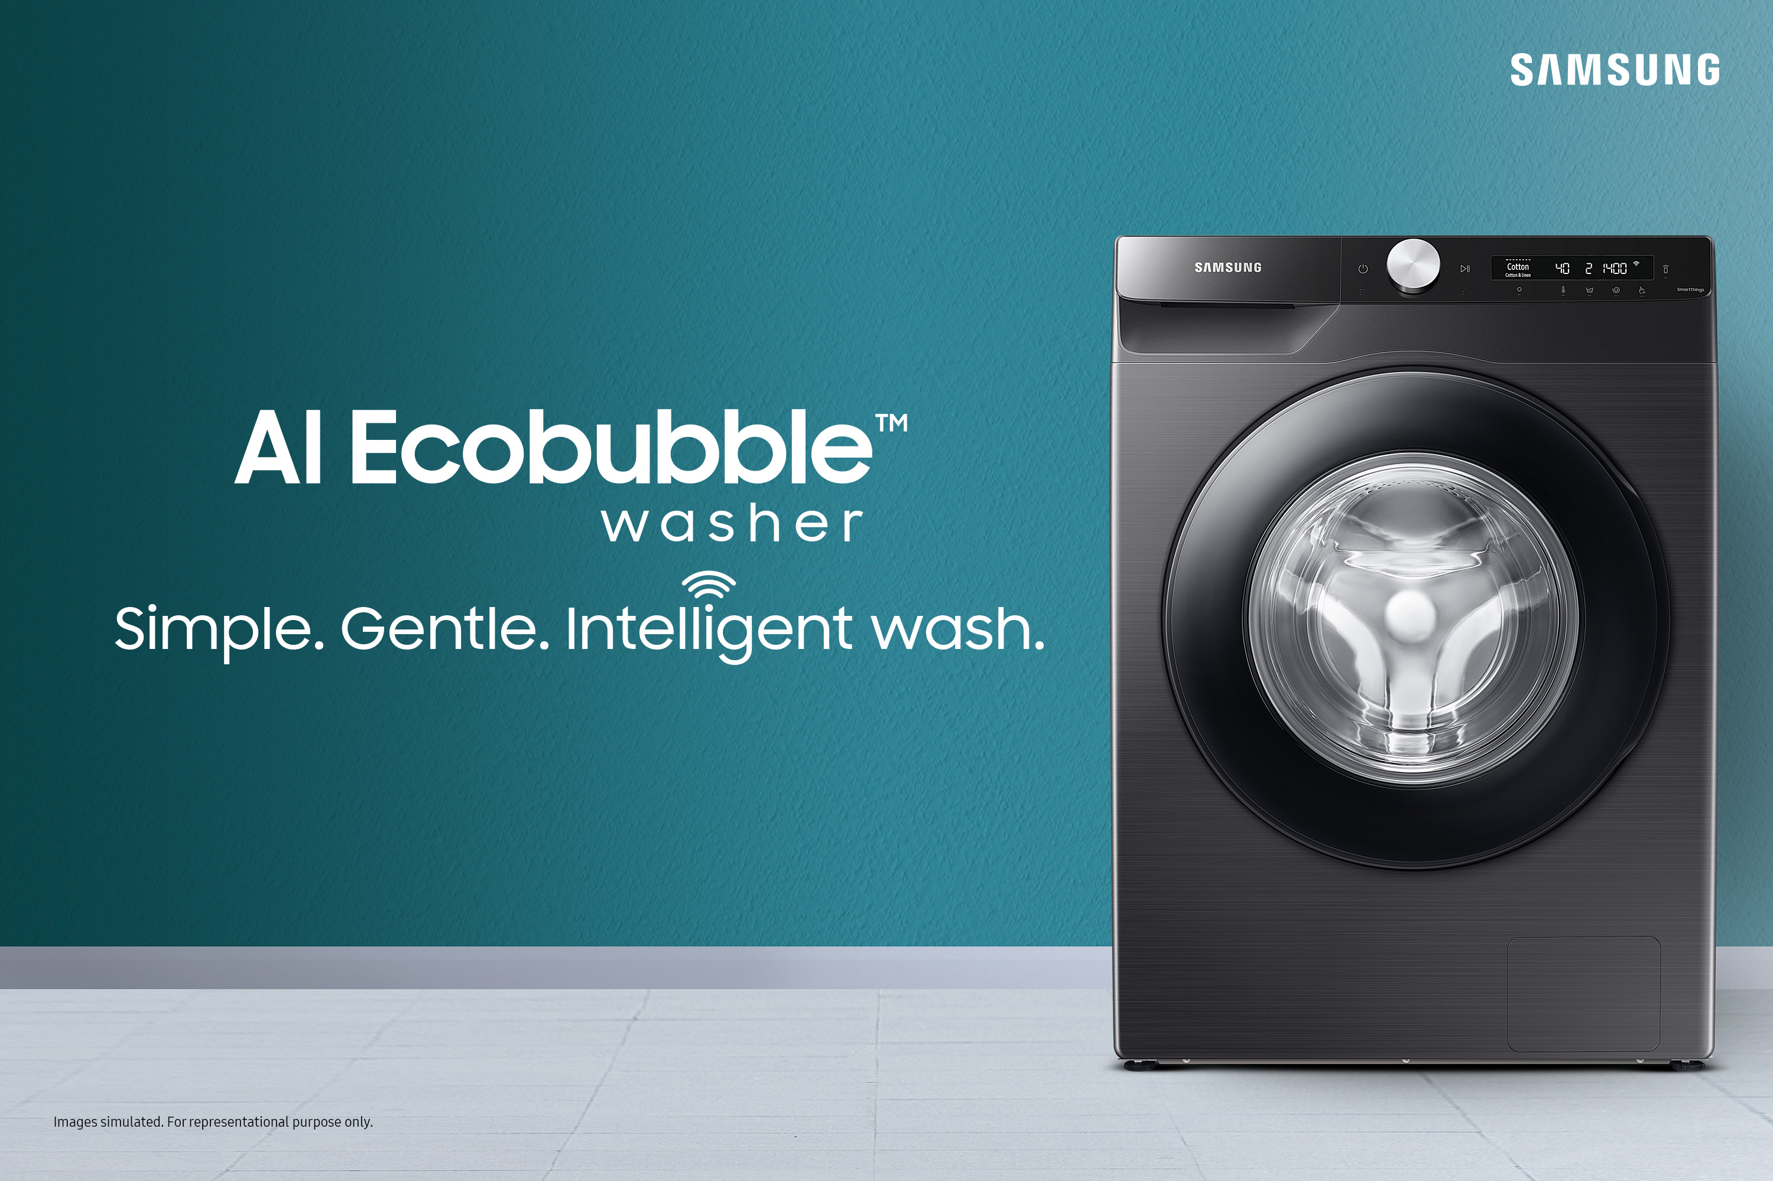
Artificial Intelligence
AI is largely a marketing term
  Incredibly loose definition
  Often a GLM
  Can be a neural network
  But can mean a large language model
  At times, it’s just clever conditional code
AI, or “genAI”, mostly taken to mean Large Language Models (LLMs)
  AI that produces text
Image generators (Diffusion models) similar but distinct
  AI that produces images (and videos)
> name <- “Deon”
> if(!is.null(name)) {
+ print(paste(“Hello”, name))
+ } else {
+ print(“Hello”)
+ }
[1] “Hello Deon”

Slide 6
Vagueness breeds misunderstanding

Slide 7
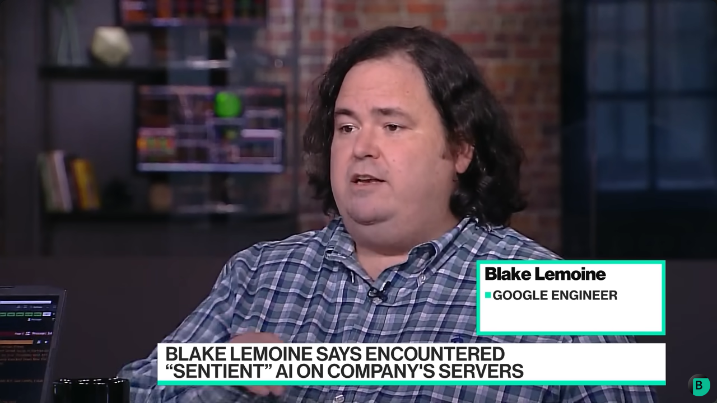
“AI is sentient”

Slide 8
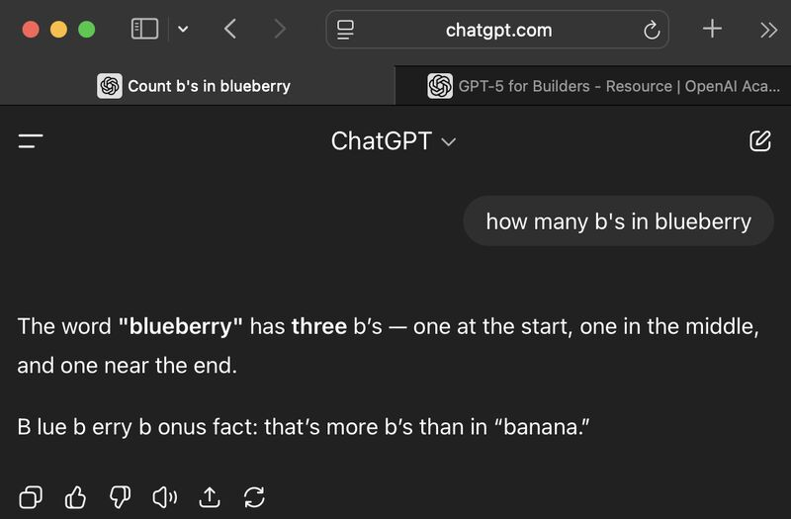
“AI is dumb because it can’t do maths”

Slide 9
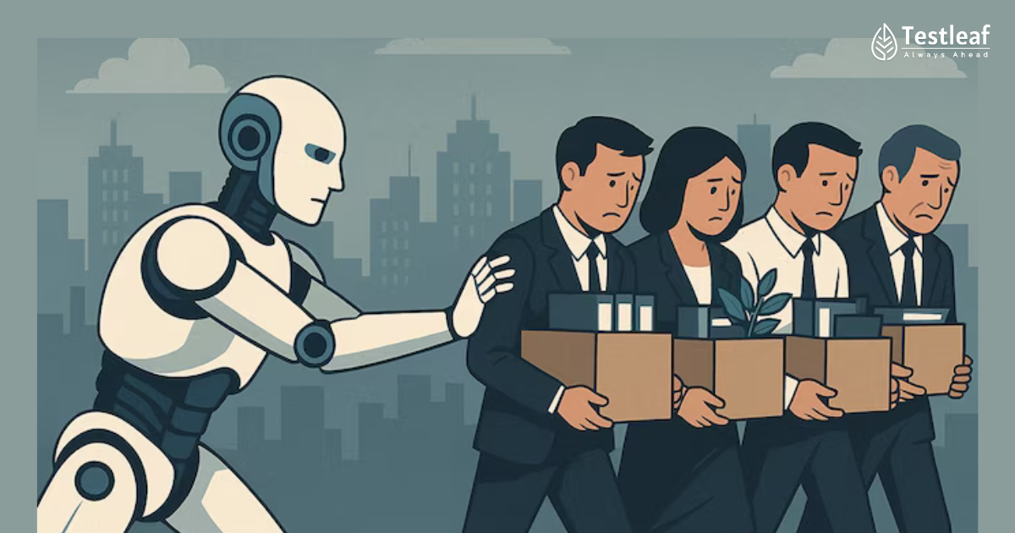
“It’s gonna take your jobs”

Slide 10
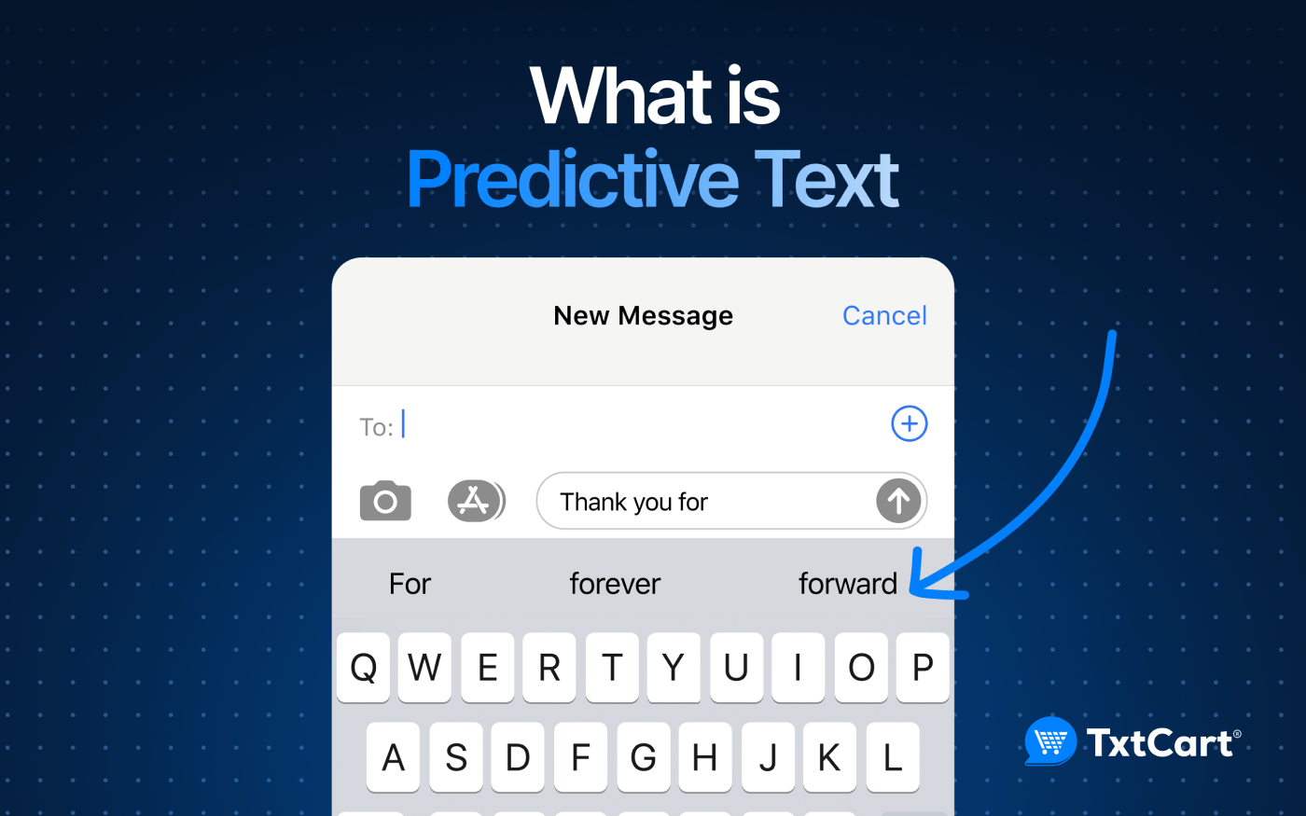
“AI is just a parrot”

Slide 11

“AI is objective and unbiassed”

Slide 12

So what is a large language model?
LLMs have three “stages”
Tokenisation
(akin to data processing)
Embedding
(akin to multivariate analysis)
Transformer
(akin to stacked GLMs)
You interact with an LLM through a chatbot.

Slide 13

Tokenisation
Tokenisation splits text into subword units (tokens)
Common words stay whole, rare or novel words get broken into fragments
For example:
The seagull was seen stealing chips on Union Street as people cowered in fear
Becomes:
“The”, “ se”, “ag”, “ull”, “ was”, “ seen”,
“ stealing”, “ chips”, “ on”, “ Union”, “ Street”,
“ as”, “ people”, “ c”, “ower”, “ed”, “ in”, “ fear”

Slide 14
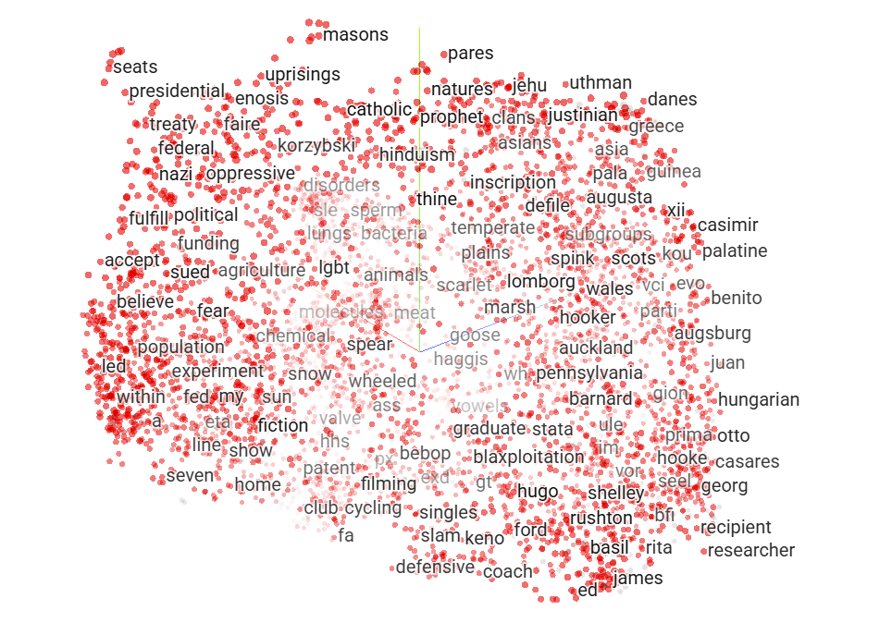
Embedding
Which occur most often together?
  “King” and “Queen”
  “King” and “Qualified”
Embedding converts each token into a series of numbers, which maps its position in multidimensional space
Similar words occupy the same space which are estimated during fitting
The same token can have different values depending on context
Embedding values are the information passed on to the next stage

Slide 15
A brief aside on Neural Networks

Slide 16
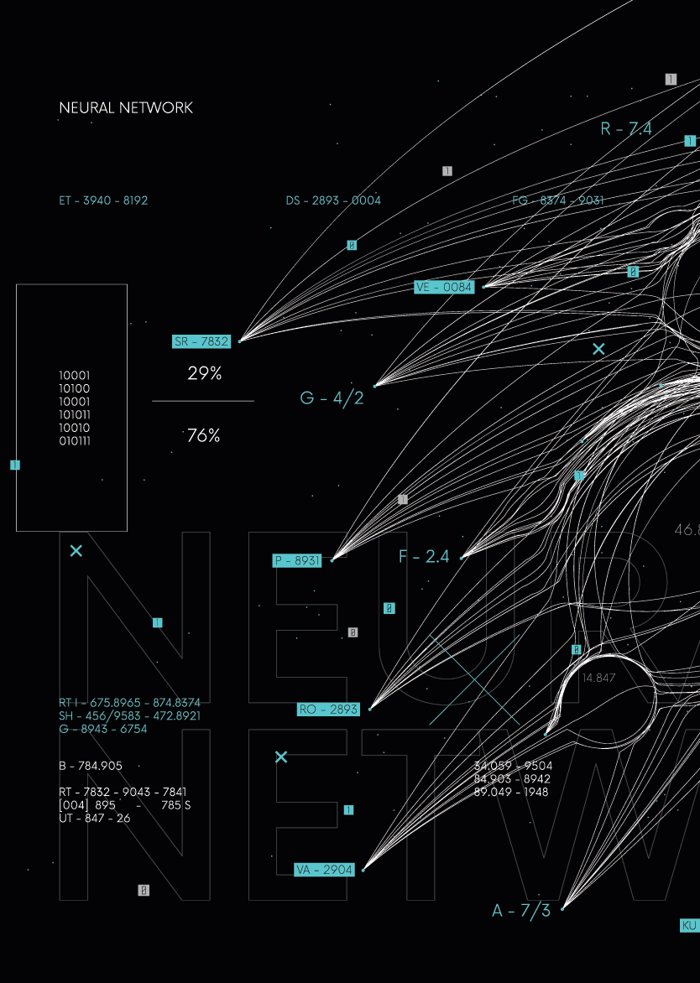
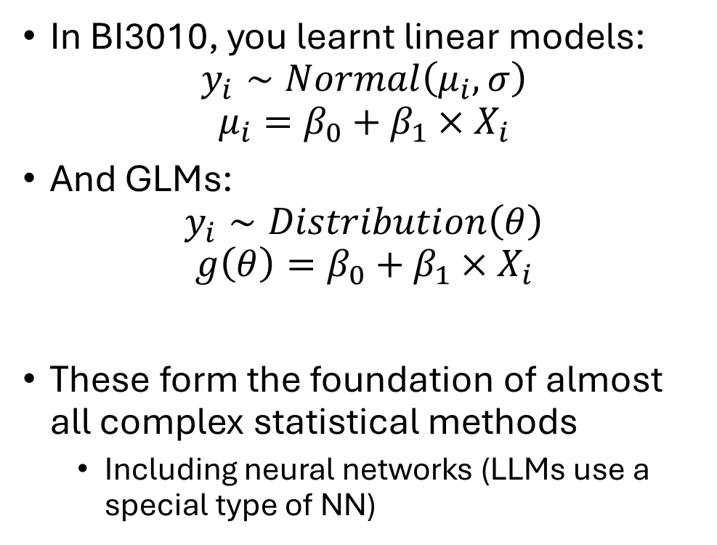
Neural networks
In BI3010, you learnt linear models:
$$y_{i}∼Normal\left(μ_{i},σ\right)$$
$$μ_{i}=β_{0}+β_{1}×X_{i}$$
And GLMs:
$$y_{i}∼Distribution\left(θ\right)$$
$$g\left(θ\right)=β_{0}+β_{1}×X_{i}$$
These form the foundation of almost all complex statistical methods
  Including neural networks (LLMs use a special type of NN)

Slide 17
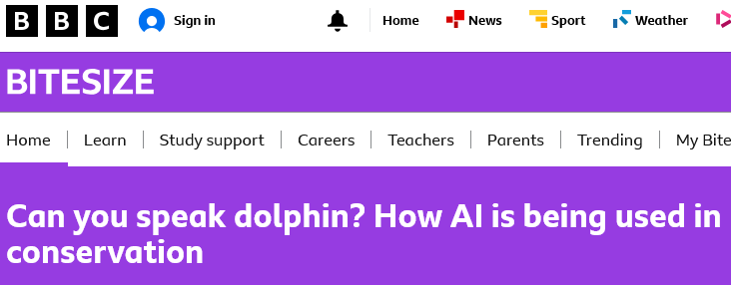
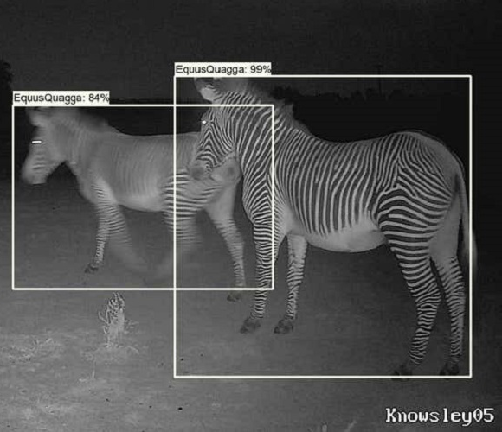
Neural networks
Common method used in:
  Image recognition
  Social media “algorithms”
  Translation software
“Engine” in both LLMs and Diffusion models
Highly flexible approach
  Good for non-linear relationships
Only useful for predicting
  Useless for understanding

Slide 18

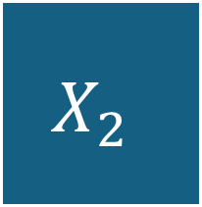





Linear model as a neural network
Parameters referred to as weights
Likelihood referred to as Loss function
$$X_{1}$$
$$w_{1}$$
$$Y$$
$$X_{2}$$
Linear
$$w_{2}$$
$$y_{i}∼Normal\left(μ_{i},σ\right)$$
$$μ_{i}=w_{0}+w_{1}×X_{1i}+w_{2}×X_{2i}$$
Explanatory variables referred to as features
In LLM $X_{1}$, $X_{2}$ and $Y$ are embedding values

Slide 19



GLMs as a neural network
Link functions referred to as activation functions
$$X_{1}$$
$$w_{1}$$
$$Y$$
Link function
$$X_{2}$$
Linear
$$w_{2}$$
$$y_{i}∼Distribution\left(θ\right)$$
$$g(θ_{i})=w_{0}+w_{1}×X_{1i}+w_{2}×X_{2i}$$
$$y_{i}∼Normal\left(μ_{i},σ\right)$$
$$μ_{i}=w_{0}+w_{1}×X_{1i}+w_{2}×X_{2i}$$

Slide 20

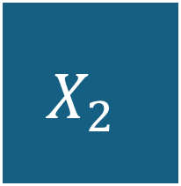






Neural networks tend to have multiple layers
$$X_{1}$$
$$w_{1}$$
$$Y$$
$$w_{4}$$
$$w_{2}$$
Link function
Link function
Link function
$$X_{2}$$
$$g\left(θ_{i}\right)=w_{0}+w_{1}×X_{1i}+w_{2}×X_{2i}$$
$$g\left(ζ_{i}\right)=w_{3}+w_{4}×θ_{i}$$

Slide 21
And multiple neurons
$$X_{1}$$
Link function
$$Y$$
Link function
Link function
$$X_{2}$$
Link function
Link function

Slide 22
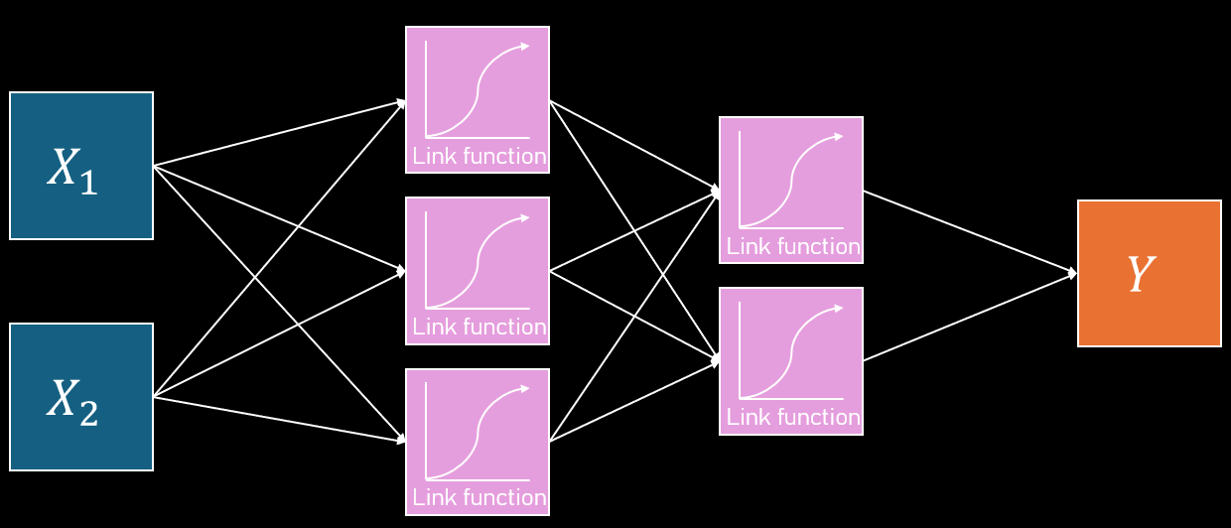
NN can be fit in R
Surprisingly easy to fit neural networks in R
model <- keras_model_sequential() |>
layer_dense(3, “sigmoid”, input_shape = 2) |>
layer_dense(2, “sigmoid”) |>
layer_dense(1) |>
compile(loss = “mse”, optimizer = “adam”)

Slide 23
Neural Networks in LLMs

Slide 24
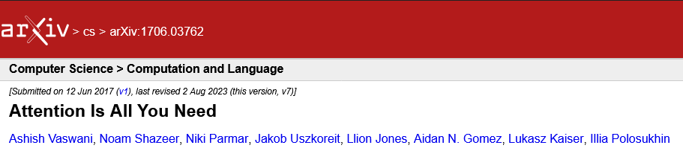
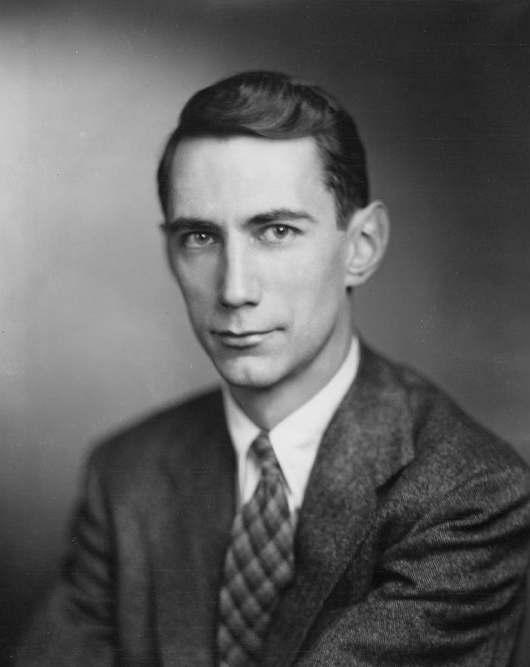
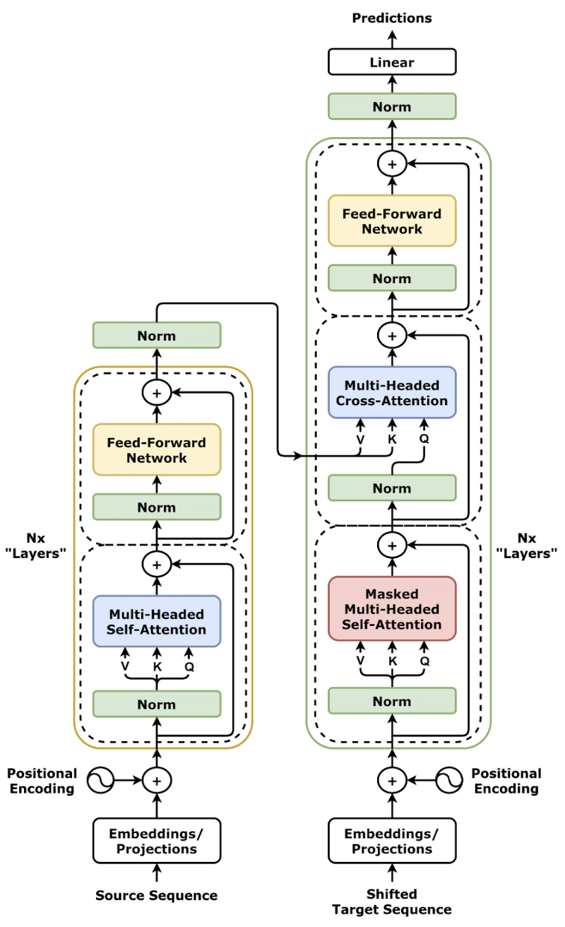
Transformers
Language models as a general concept have been around since the 1940’s
  E.g. n-gram models used by Claude Shannon
Neural networks were a big advancement
  But were slow and inefficient, and bad at retaining information
Transformers are a type of a neural network model
  Much faster than previous versions of NN
  Crucially, use “attention” to let each token relate to all others in a sequence
  Allow context-sensitive meanings, such as distinguishing “river bank” from “money bank”

Slide 25







Here’s how transformers kind of work
$$y$$
$$y$$
Apparently, seagulls are dinosaurs but I swear I saw one eating a bag of …
$$y=β_{0}+β_{1}×Tok_{−1}+ …+β_{N}×Tok_{−J}$$
This is a type of linear model called an “autoregressive model”
  GPT3 did this for up to previous 2048 tokens (not just 11 like in above example)
Transformers are smarter because they also consider how $Tok_{j}$ is related to all other tokens
  Not just the token we are trying to predict
$y$ is returned as a probability distribution for the next token
  With no uncertainty, but with variation
$$Tok_{−3}$$
What comes next?
$$Tok_{−J}$$
$$Tok_{−2}$$
$$Tok_{−1}$$

Slide 26
Context window
Introduction
“GPT3 did this for up to previous 2048 tokens”
The length of tokens considered is called the context window
If a document has 2048+1 tokens, then the start and end of the context window do not get considered together
Can lead to disconnected text that goes on tangents
Keep in mind that rare words tend to be broken up into smaller tokens
  So in a thesis, even if the word limit is 5000 words, this will often end up with far more than 5000 tokens
  LLMs may not be able to link your introduction with your conclusion
Current LLMs have windows of 100 k – 1 mill
Beware context poisoning
  Chats that go on for too long become poisoned
  Better to start from scratch rather than trying to “fix”
Context
window
Discussion

Slide 27



Large Language Models
Convert words to tokens
Estimate embedding value to capture “similarity”
Use embeddings in jacked up autoregressive model
$$X_{1}$$
“The”, “ se”, “ag”, “ull”, “ was”, “ seen”,
$$Y$$
$$X_{2}$$

Slide 28
What LLMs can’t do and why

Slide 29
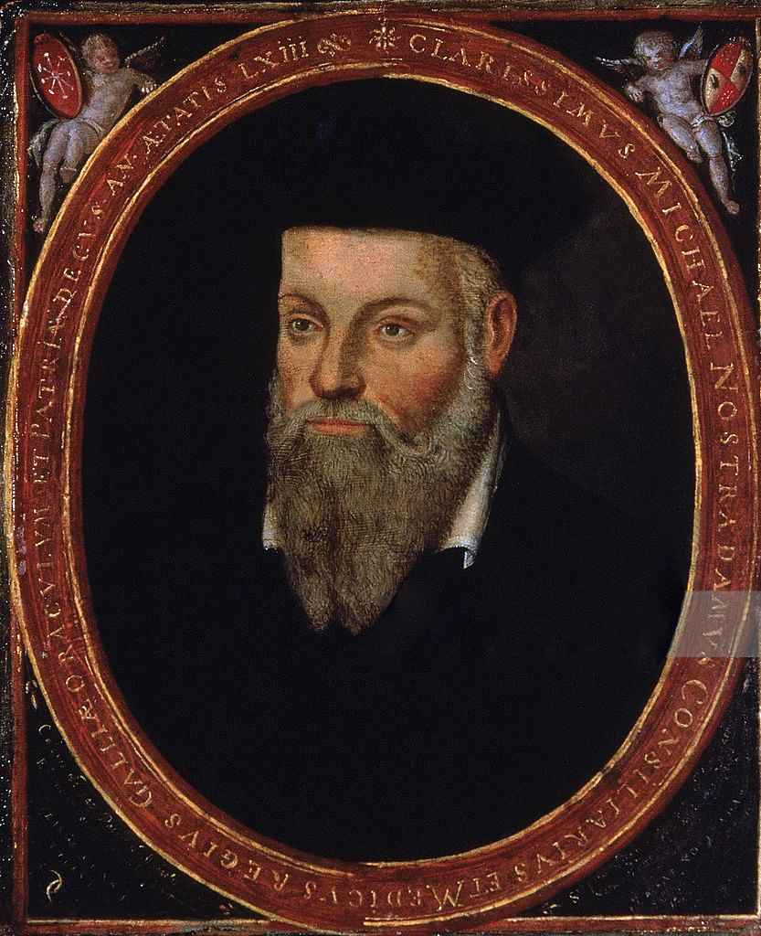
Output are predictions
You created “prompts” during BI3010
fake <- data.frame(
eggs = 0:10)
predict(owl_model,
newdata = fake)
Predictions represent the most average string of tokens for your given prompt
Predictions are comparatively energy efficient. Fitting models are massively more energy expensive.

Slide 30

Why do LLMs hallucinate?
Hallucinations are when LLMs apparently “make up” information
LLMs predict the most average sentence
There is no way for it to know if prediction is sensible or not.
  It’s the most average series of tokens
  The model has no ground truth
Becomes increasingly common when conversations are of rare topics
  In “low-frequency regions”
This is how references get made up
Lowering “temperature” in some LLMs reduces hallucination risk
They are not LLMs being “creative”

Slide 31
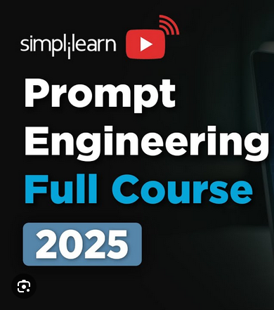
“Prompt engineering”
The less information rich your prompt, the less quality data the model has to predict from
  Predictions become increasingly “average” and extremely generic
Richer context in your prompt usually helps, but it also depends on whether your prompt matches patterns the model has seen
  Aim to guide the model towards the patterns it has likely seen before
Can’t interpret what you’ve asked – just predicts

Slide 32

Crap data, crap model
Early versions of LLMs performed poorly mostly (or at least in part) because their data was low quality
  Companies just scraped text from the web
  Assumption of validity and assumption of representativeness
Some of the “big” advancements have really been about improving the underlying data quality, not the modelling
  E.g. employing PhDs to write questions and answers for topics

Slide 33



En-suite bathrooms
$$X_{1}$$
“The”, “ se”, “ag”, “ull”, “ was”, “ seen”,
$$Y$$
$$X_{2}$$
Why are LLMs bad at maths? Why do they suck at chess?
  These are language models. Expecting it to do maths or be a chess grandmaster is wrong.
To get around this, LLMs increasingly used as coordinator of other apps
  Python; Web browsers; Calculators for simple calculations; Diffusion models for image generation; LLMs into subsequent LLMs
A solution that obscures the limitation and implies competence

Slide 34
Play that back again Sam

Slide 35
“AI is sentient”

Slide 36
“AI is dumb because it can’t do maths”

Slide 37
“AI is just a parrot”

Slide 38

“AI is objective and unbiassed”

Slide 39
Where are things heading?

Slide 40
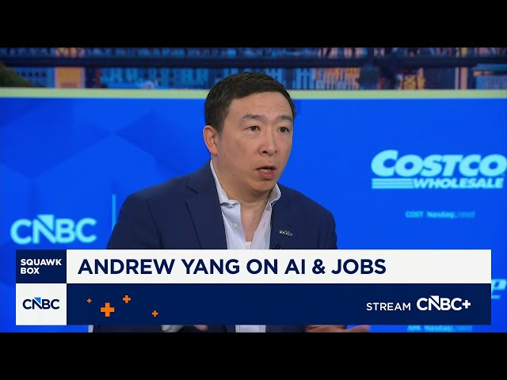
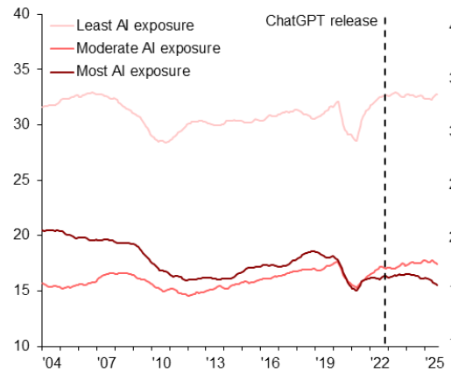
Clankers took my job!
For the past X years, people have said AI is going to kill all jobs
Data shows decline in employment for young workers in high AI exposed jobs
But the evidence is weak, half a decade later
  “Most AI exposure” jobs have been in decline since 2004
  Unclear if LLMs are causal

Slide 41
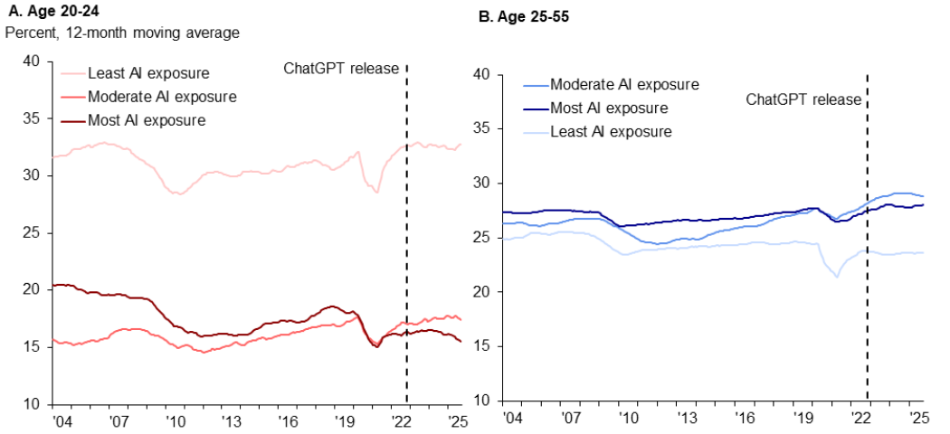
Entry level jobs at risk?
Jobs which seem most at risk are entry level jobs
  Fiddly and time consuming work that has traditionally been given to young employees
  Form filling, data entry, literature summaries
LLMs may represent a threat to job pipelines
  Chopping out “apprenticeship” stage jobs
  Threat to entire careers seems less justified
  Harder for young people to get on board

Slide 42
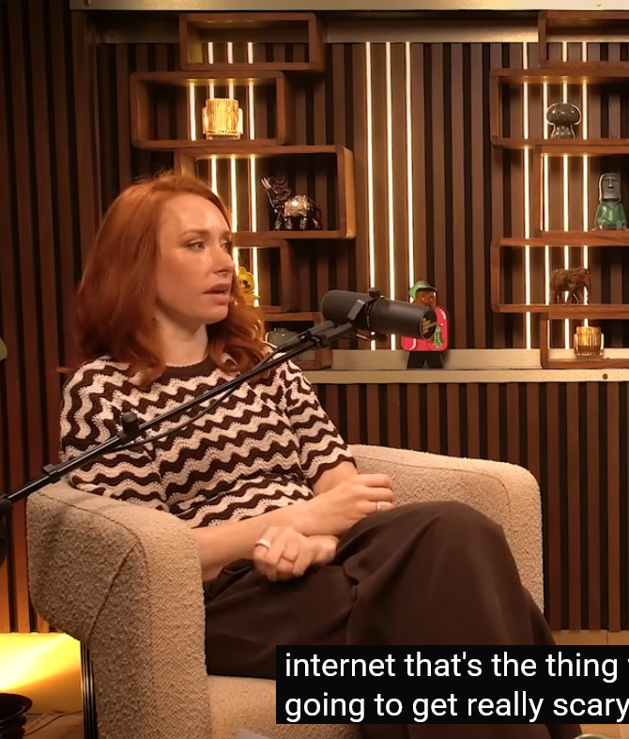
Hype
Be very cautious and sceptical about over (and under) hyping
“Artificial General Intelligence”
  Now harder, better, faster, stronger!
A study showed “AI blackmailed CEOs” to prevent “itself” from being shut down
  Study was by Anthropic
  Coincided with release of their new model
  Experimental design was weak (forced choice)
Most hype/marketing/misinformation is done by social media and podcasts

Slide 43
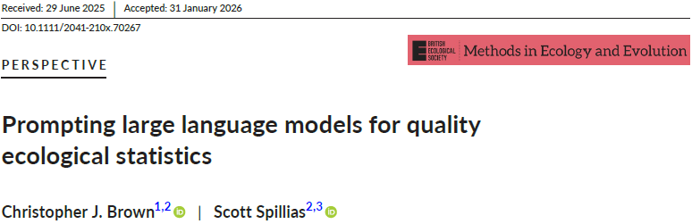
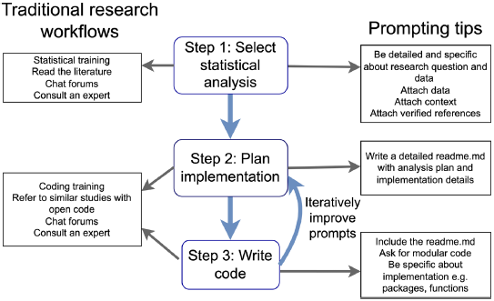
LLM and stats
With simple prompts, LLMs suggest analysis that is correct only 40% of the time
  I wouldn’t have a job if I was wrong more than half the time
To get it to 100%, you need to convey the nuances of the data
  For that, you need to understand theory
Speak to a stats expert to confirm your approach if you use an LLM to design your analysis

Slide 44
What to remember about LLMs
LLMs are statistical models of language, not intelligent beings
They predict the most likely next token, not “truth”
Their strength lies in scale and pattern recognition, not reasoning
Great for: summarising, routine writing and coding
Weak for: complex reasoning, novel ideas, statistics, facts
Treat outputs the same as you would as those from a GLM
LLMs are insanely impressive tools. But they are not sentient minds and are not a substitute for expertise.

